Slide 1
Summarication for Artficles and reviews
Team’s Names: Unsuperivsed:
Mostafa Tarek Gaber 94071 ENG: Ahmed Hesham
Mohamed Ezz Elregal 94303
Abdelrahman Wael 94109
Nour Ehab 94330
Omar Khaled 94105

Slide 2
Problem defination: NLP model that summarizes text for various purposes involves extracting essential information from the user's data to initiate the summarization process. The model aims to identify and condense key points from the provided text.

Slide 3
Model roadmap
Starting with tokenization of the text, which helps determine the type of each word (noun, verb, etc.),
Loading the Arabert Google checkpoint helps improve the preprocessing and model fitting processes.
Train the model using 50 epochs with decaying learning rate starting at 0.0001.
Using the loss score and rough score to determine the performance of the model, start predicting on the data.
Start predicting on the data

Slide 4
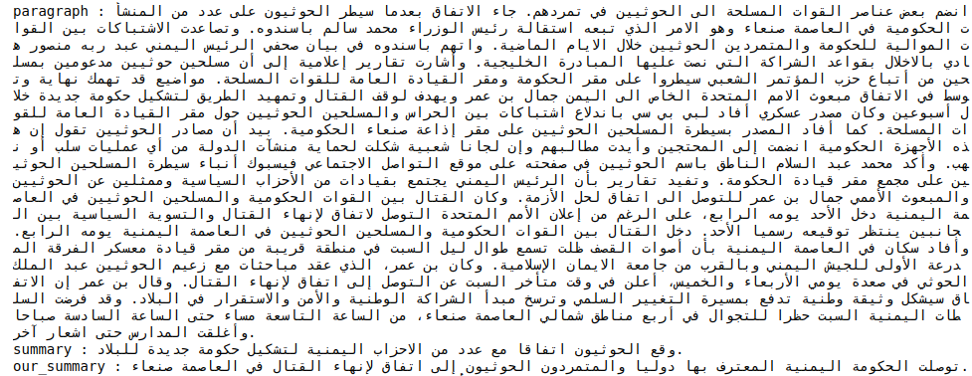

Slide 5
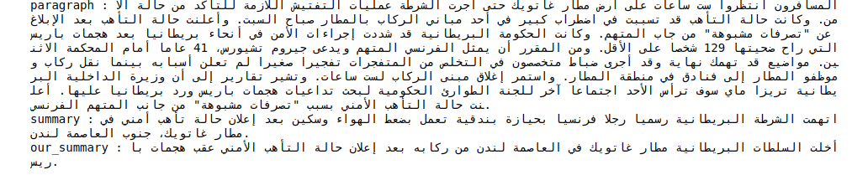
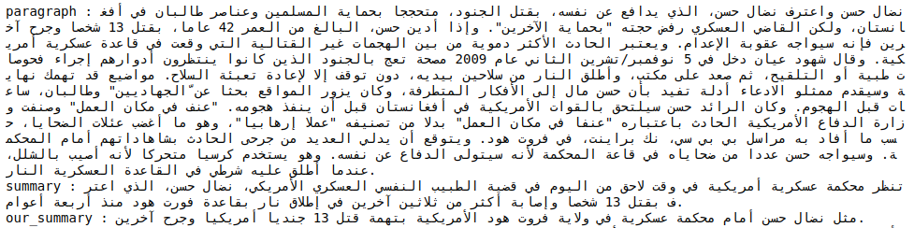

Slide 6
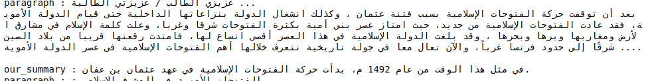
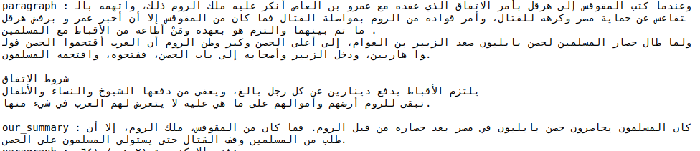
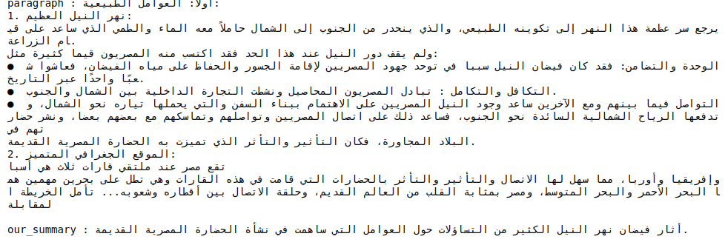

Slide 7
Resources
https://keras.io/examples/nlp/t5_hf_summarization/
https://huggingface.co/UBC-NLP/AraT5-base
https://huggingface.co/abdalrahmanshahrour/arabartsummarization

